Slide 1
Implantation: a challenge
Prof. Juan A Garcia-Velasco
IVI – Madrid

Slide 2
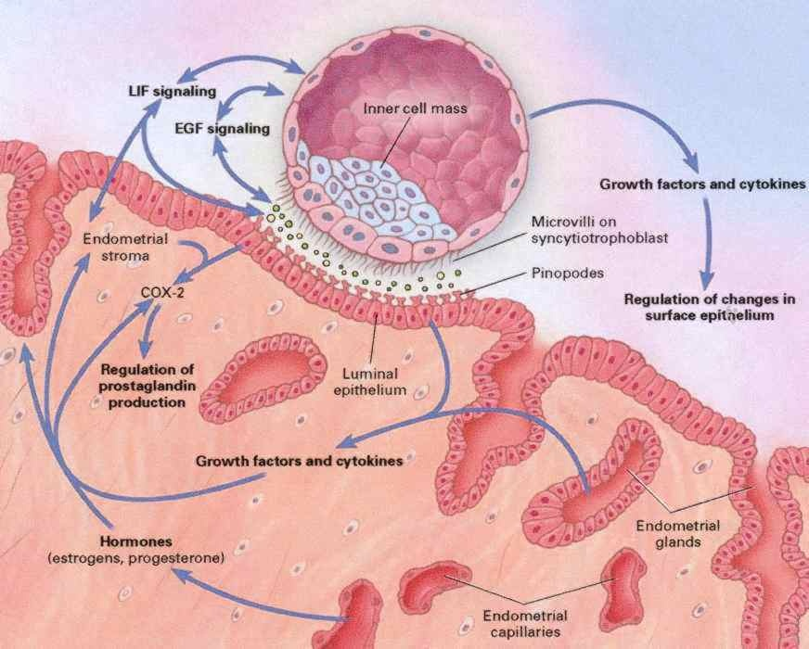
The process of implantation

Slide 3
Embryo Aneuploidies
Drosophila | 0.01 %
Mouse | 0.01 %
Human | 20 – 100 %
Implantation Rate (IR)
Natural cycle | 35 %
Euploid embryos | 60-65 %
Rodents | 95 %
Rabbits | 96%

Slide 4
Implantation Rates Amongst Euploid Embryos with Increasing Maternal Age
Sample Size
Day 3: 508
Blast: 543
Harton GL et al Fertil Steril 2013 100:1695-1703
Notes:
IR up to 42 are similar, then they declinde after array CGH

Slide 5
IVIRMA Basking Ridge, NJ
2011 - 2018
8,349 euploid embryo transfers
Reig A et al. ASRM 2019
Notes:
since this is when they started offering routine PGT-A,
we obtained 8,349 embryo transfers for a retrospective study,
divided into the 5 age groups as is shown here.

Slide 6
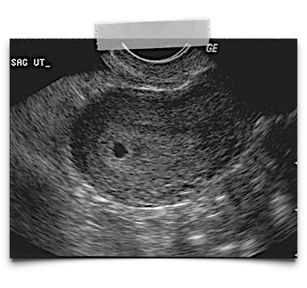
ß
biochemical
pregnancy
clinical
pregnancy
live
birth
Notes:
For each of these groups, we measured three outcomes:
Biochemical pregnancy rate: a positive ß-hCG 9-10 days after embryo transfer,
Clinical pregnancy rate: visualized gestational sac on ultrasound,
and Live birth rate: which is pretty self explanatory. Based on this criteria, we queried the database of a single IVF center between 2011 and 2018,

Slide 7
Pregnancies in euploid embryos and age
p < 0.0001
p = 0.0132
p = 0.4238
Reig A et al. ASRM 2019
Notes:
So we then evaluated the percentage of pregnancies making it to each next step. With the implantation rates from the previous analysis,
we assessed how many of those implanted embryos progressed to clinical pregnancies, and then how many of those made it to live births.
This showed a significant difference in implantation and clinical pregnancy rates based on age,but how many of those clinical pregnancies resulted in live births was not significant.

Slide 8
Why euploid embryos from aged women have reduced implantation?
It is not all about oocyte aneuploidy
Detrimental effect of aged sperm
The uterus also gets “old”

Slide 9
Implantation Rates in Euploid Embryos
No implantation : 1335 30.1%
implantation : 3094
69.9%
1st Embryo Transfer
Drop out 571
Remaining embryos 519
New Art treatment 245
No implantation : 307 40.2%
implantation : 457
59.8%
2nd Embryo Transfer
Drop out 176
Remaining embryos 92
New Art treatment 39
No implantation : 52 39.7%
implantation : 79
60.3%
3rd Embryo Transfer
Pirtea P et al, ASRM 2019
Notes:
Furthermore, our logistic regression model showed that 2nd FE-SETs resulted in slightly decreased IRs compared to the 1st FE-SET (OR=0.641 95% CI= 0.547-0.752), as was also the case for 3rd FE-SETs (OR=0.649, 95% CI= 0.455-0.932). There were however no differences in IR between the 2nd and 3rd SE-FETs.
IR barely decreased from 69.9% to 59.8% following the 1st failed implantation of a euploid embryo. This indicates that failed implantation following a FE-SET does not select out women with overt receptivity disorders. Indeed, considering that the first FE-SET were morphologically selected, it is reasonable to estimate that the difference between the 1st and 2nd IR– 69.9% and 59.8%, respectively – is in part the reflection of embryo selection for the 1st transfer.

Slide 10
Live Birth Rates in Euploid Embryos
No implantation : 1335 30.1%
implantation : 3094
69.9%
Live Birth
64.8%
1st Embryo Transfer
Drop out 571
Remaining embryos 519
New Art treatment 245
No implantation : 307 40.2%
implantation : 457
59.8%
Live Birth
54.4%
2nd Embryo Transfer
Drop out 176
Remaining embryos 92
New Art treatment 39
No implantation : 52 39.7%
implantation : 79
60.3%
Live Birth
54.1%
3rd Embryo Transfer
Pirtea P et al, ASRM 2019

Slide 11
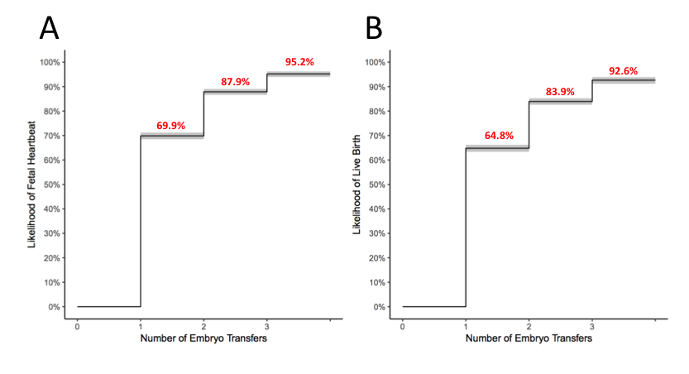
Implantation and Live Birth Rates
in Euploid Embryos
Pirtea P et al, ASRM 2019

Slide 12
How to manage failed implantation from an uterine perspective?
Ultrasound evaluation
Hysteroscopy
Endometrial scratching
Endometrial transcriptomics
Microbiome analysis

Slide 13
Introduction
The role of ultrasound:
Features of adenomyosis
7 ultrasound features - Adenomyosis
Asymmetrical myometrial thickening (not caused by fibroids)
Parallel shadowing
Linear striations
Myometrial cysts
Hyperechoic islands
Adenomyoma: ill-defined nodular heterogeneous myometrial mass
Irregular endometrial-myometrial junction
Naftalin et al. Hum Reprod 2012
Notes:
EMJ= endometrial myometrial Junction

Slide 14
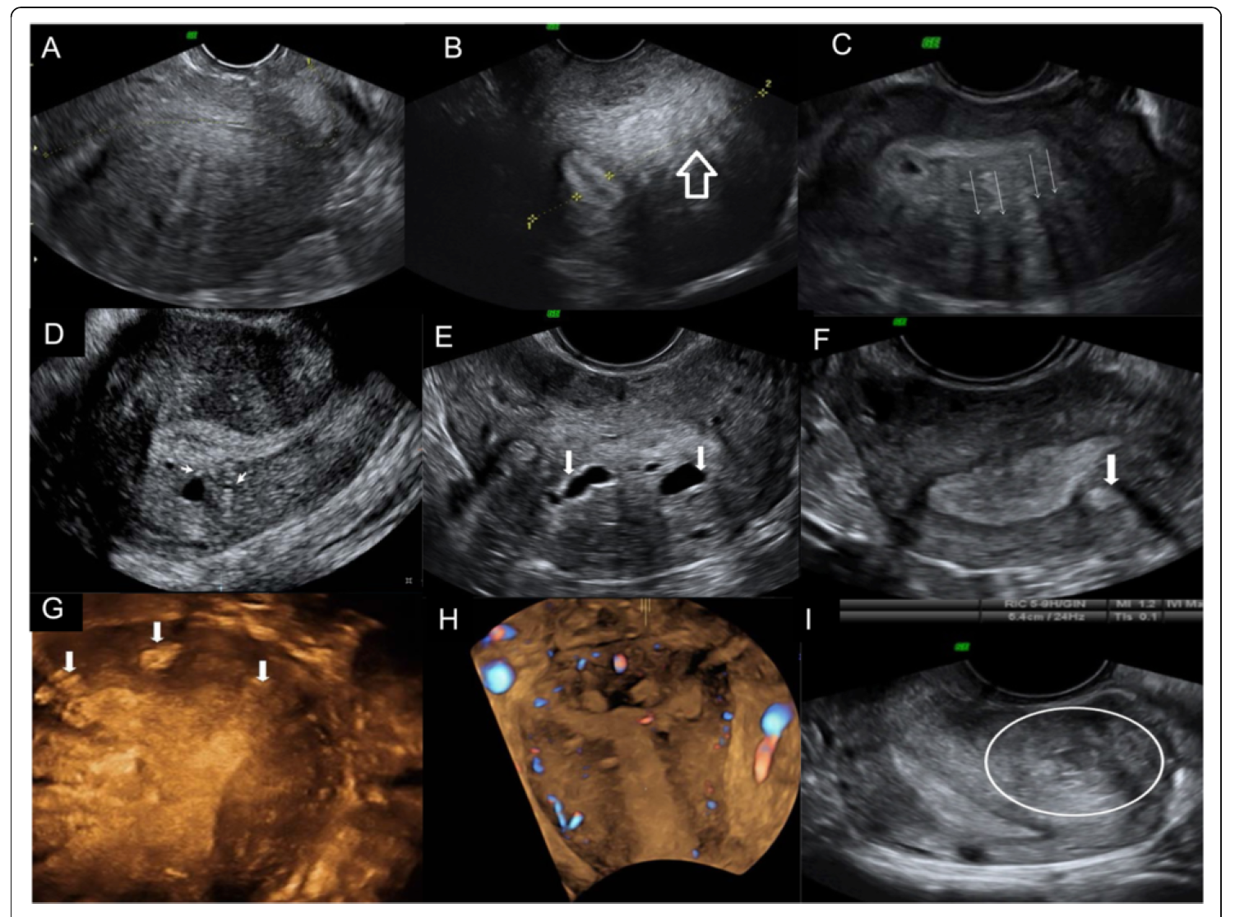
Globulous aspect of the uterus
Uterine asymmetry
Heterogeneous myometrial texture
Linear striations
Intramyometrial cysts
Hyperechogenic nodules
Puente et al. Reprod Biol Endocrinol 2016
Hyperechogenic nodules
Hyperechogenic nodules
Adenomyoma

Slide 15
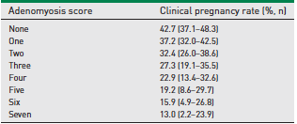
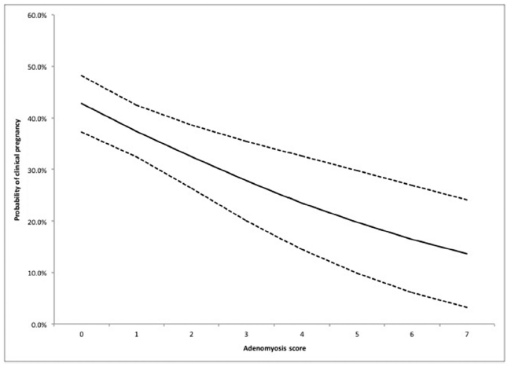
Introduction
The role of ultrasound:
Features of adenomyosis
Probability of clinical pregnancy
Mavrelos et al, RBMOnline 2017; 35: 549-554

Slide 16
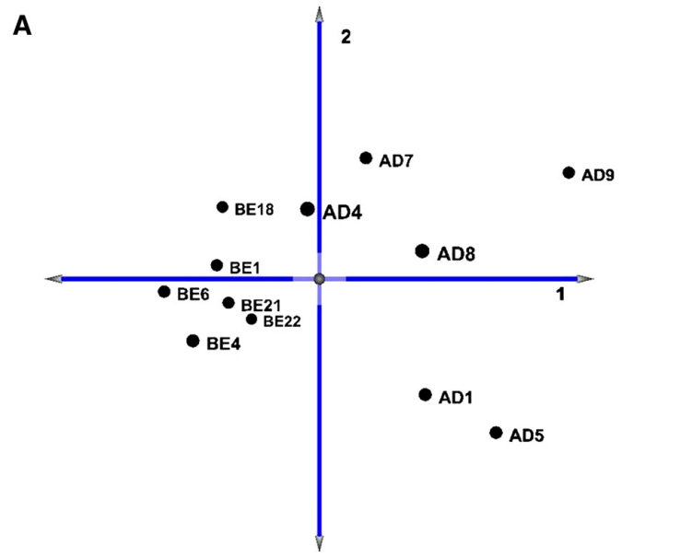
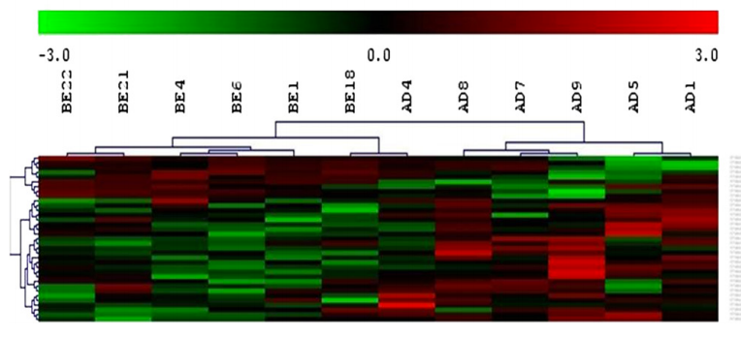
Introduction
Adenomyosis and implantation
Is there any disregulation of WOI gene?
controls
adenomyosis
34 dysregulated genes
Martinez-Conejero et al. 2011

Slide 17
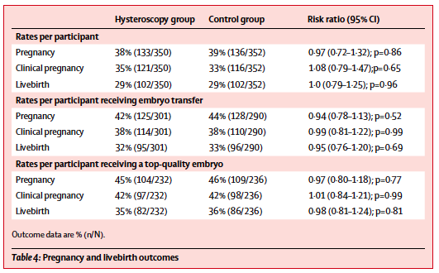
Introduction
Uterine evaluation in failed ART: The role of Hysteroscopy
TROPHY trial
The Lancet
2016
USELESS
El-Toukhy et al. Lancet 2016; 387: 2614-21

Slide 18
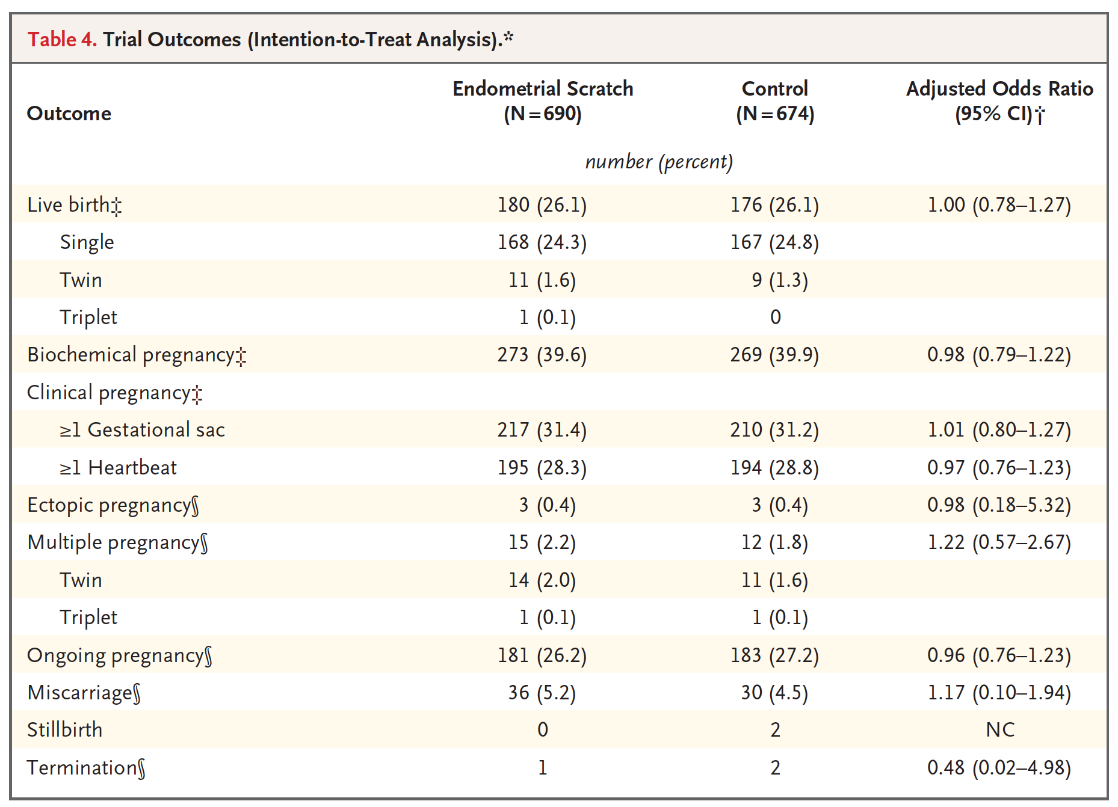
Introduction
Endometrial “scratching”
USELESS
Lensen et al. NEJM 2019; 380: 325

Slide 19
How to manage failed implantation from an uterine perspective?
Endometrial transcriptomics
Different commercially available tests
No independent, well-done study published

Slide 20
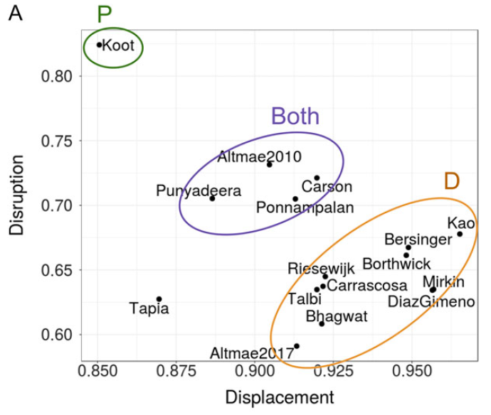
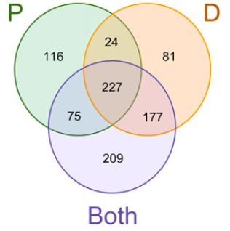
How to manage failed implantation from an uterine perspective?
Sebastian-Leon et al. Hum Reprod 2018

Slide 21
How to manage failed implantation from an uterine perspective?
Microbiome analysis
No independent, well-done study published

Slide 22
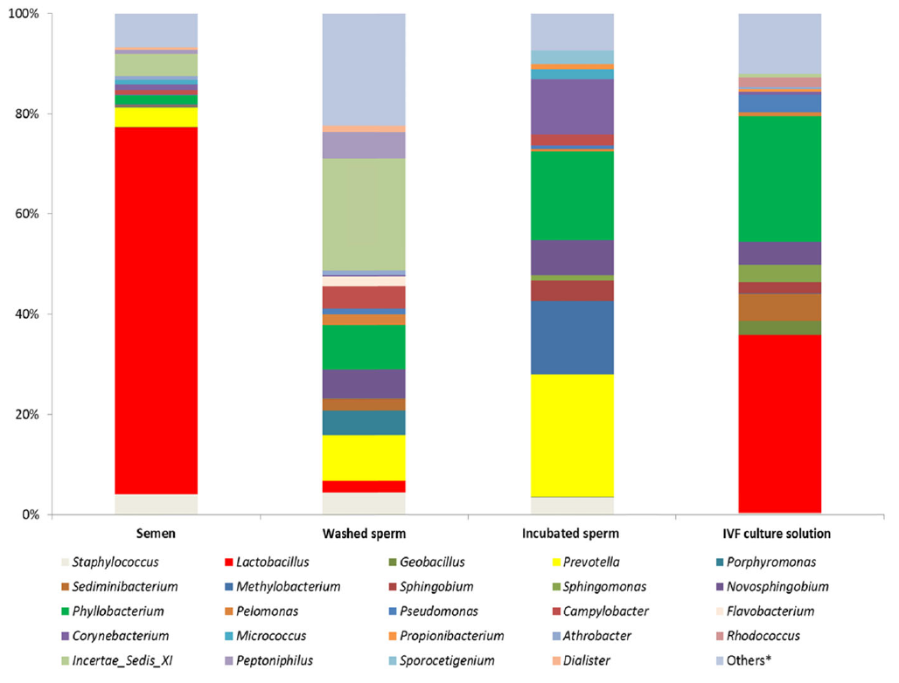
IVF is not “sterile”
Spsepetova et al. Reprod Biol Endocrinol 2020

Slide 23
31.3%
99 IVF patients < 40 y.o.
blastocyst transfer in HRT cycle
mock ET for sampling
DB
 | Dysbiotic endometrium | Eubiotic endometrium
Pregnancy rate (%) | 52.9 | 54.8
Miscarriage (%) | 11.1 | 5.9
Hashimoto and Kyono. JARG 2019
Notes:
Avoid overintervention against non-Lactobacillus microbiota

Slide 24
Haahr et al. Denmark
qPCR targetting Atopobium vaginae and Gardenerella vaginallis
Sample size
111
Clindamycin 300mg/12h
+
L. crispatus till week 7
111
Clindamycin 300mg/12h
+
PLACEBO
1
2
3
111
PLACEBO
+
PLACEBO
EudraCT 2016-002385-31

Slide 25
CONCLUSIONS
The main driver of implantation is the embryo
True implantation failure is very limited (<5-10%)
Still, we need to consider:
- the uterine morphology
- the endometrium – transcriptomic signature?
- the microbiome ?
- immunology?

